Slide 1
Repetition and Loop Statements Lesson-5

Slide 2
Objectives
To understand why repetition is an important control structure in programming
To learn about loop control variables and the three steps needed to control loop repetition
To learn how to use for, while, and do-while statements for writing loops and when to use each statement type in C language
To learn how to accumulate a sum or a product within a loop body

Slide 3
Objectives
To learn common loop patterns such as counting loops, sentinel-controlled loops, and flag-controlled loops
To understand nested loops and how the outer loop control variable and inner loop control variable are changed in a nested loop

Slide 4
Repetition in Programs
loop
a control structure that repeats a group of steps in a program
loop body
the statements that are repeated in the loop

Slide 5
Comparison of Loop Kinds
counting loop
we can determine before loop execution exactly how many loop repetitions will be needed to solve the problem
while, for
sentinel-controlled loop
input of a list of data of any length ended by a special value
while, for

Slide 6
Comparison of Loop Kinds
endfile-controlled loop
input of a single list of data of any length from a data file
while, for
input validation loop
repeated interactive input of a data value until a value within the valid range is entered
do-while
general conditional loop
repeated processing of data until a desired condition is met
while, for

Slide 7
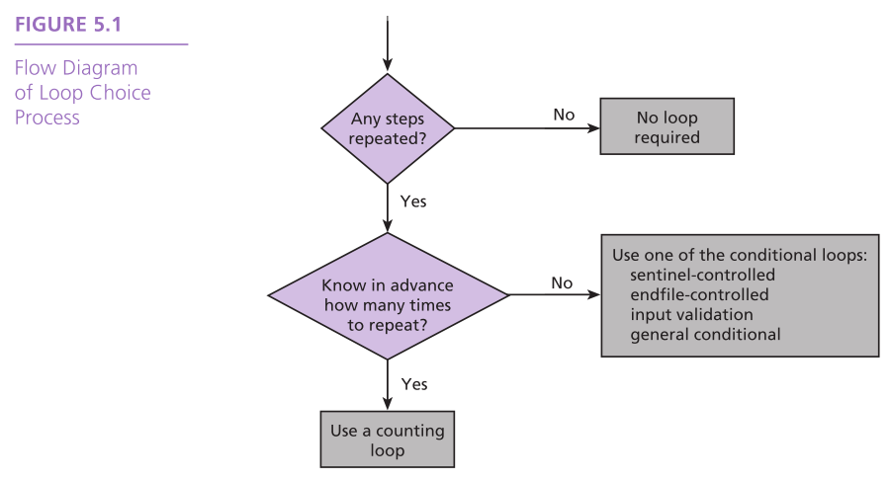

Slide 8
Counting Loops
counter-controlled loop
a.k.a. counting loop
a loop whose required number of iterations can be determined before loop execution begins
loop repetition condition
the condition that controls loop repetition

Slide 9
Counting Loops
loop control variable
the variable whose value controls loop repetition
infinite loop
a loop that executes forever

Slide 10
while Statement Syntax
while (loop repetition condition)
statement;
/* display N asterisks. */
int count_star = 0;
int N;
while (count_star < N) {
printf(“*”);
count_star = count_star + 1;
}

Slide 11
while Loop code fragment
/*program fragment with a Loop*/
int count_emp =0; /*no employee processed yet*/
while(count_emp <7){ /*test value of count_emp*/
printf(“Hours:”);
scanf(“%d”, &hours);
printf(“Rate:”);
scanf(“%1f”, &rate);
pay = hours*rate;
printf(“Pay is $%6.2f\n”, pay);
count_emp = count_emp+1; /*count_emp increment*/
}
printf(“\n All employees processed\n”);

Slide 12
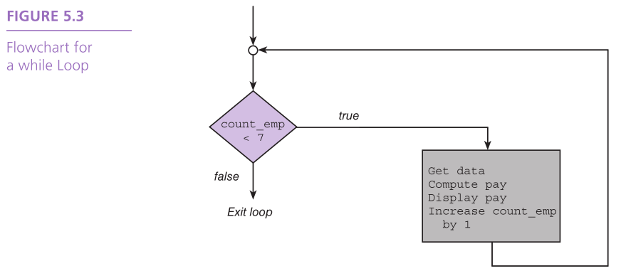

Slide 13
Computing a Sum or Product in a Loop
accumulator
a variable used to store a value being computed in increments during the execution of a loop

Slide 14
Payroll System for A Company
Run Code
See Code

Slide 15
General Conditional Loop
Initialize loop control variable.
As long as exit condition hasn’t been met
Continue processing

Slide 16
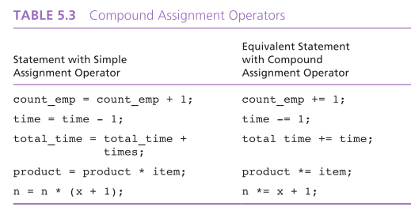

Slide 17
Loop Control Components
initialization of the loop control variable
test of the loop repetition condition
change (update) of the loop control variable
the for loop supplies a designated place for each of these three components

Slide 18
The for Statement Syntax
for (initialization expression;
loop repetition condition;
update expression)
statement;
/* Display N asterisks. */
for (count_star = 0;count_star < N; count_star += 1)
printf(“*”);
/*Display N asterisks.*/
for (count_star = 0; count_star<N; count_star=+10)
printf(“*”

Slide 19
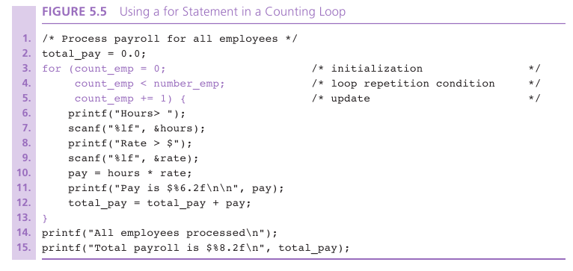

Slide 20
Increment and Decrement Operators
counter = counter + 1 count += 1 counter++
counter = counter - 1 count -= 1 counter--

Slide 21
Increment and Decrement Operators
side effect
a change in the value of a variable as a result of carrying out an operation

Slide 22
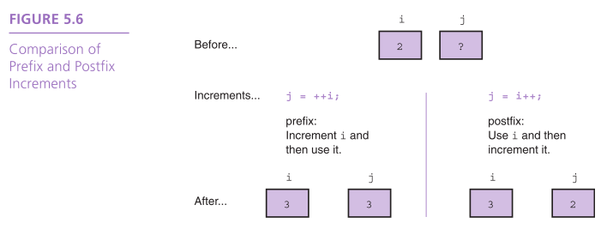

Slide 23
Computing Factorial
loop body executes for decreasing value of i from n through 2
each value of i is incorporated in the accumulating product
loop exit occurs when i is 1

Slide 24
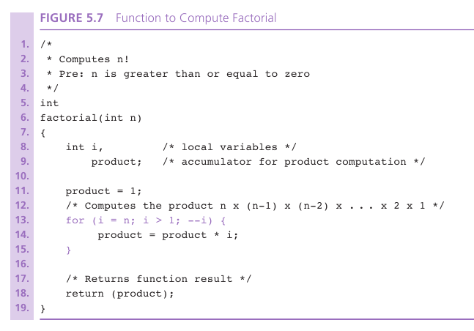

Slide 25
Conversion of Celsius to Fahrenheit
example shows conversions from 10 (CBEGIN) degree Celsius to -5 (CLIMIT) degrees Celsius
loop update step subtracts 5 (CSTEP) from Celsius
accomplished by decreasing the value of the counter after each repetition
loop exit occurs when Celsius becomes less than CLIMIT

Slide 26
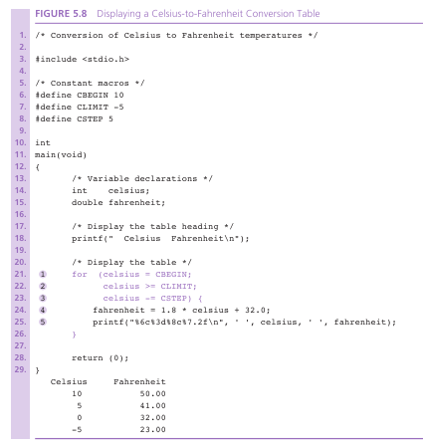

Slide 27
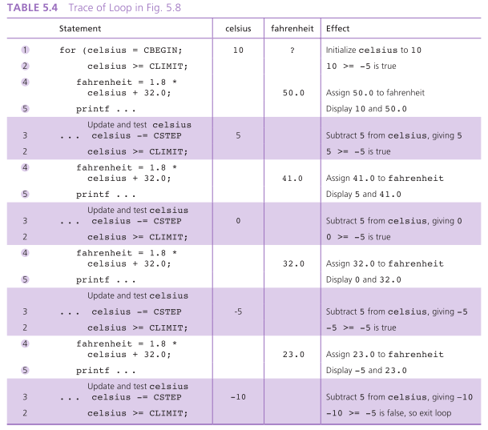

Slide 28
Conditional Loops
used when there are programming conditions when you will not be able to determine the exact number of loop repetitions before loop execution begins

Slide 29
Loop Design
Sentinel-Controlled Loops
sentinel value: an end marker that follows the last item in a list of data
Endfile-Controlled Loops
Infinite Loops on Faulty Data

Slide 30
Sentinel Loop Design
Correct Sentinel Loop
Initialize sum to zero.
Get first score.
while score is not the sentinel
Add score to sum.
Get next score

Slide 31
Sentinel Loop Design
Incorrect Sentinel Loop
Initialize sum to zero.
while score is not the sentinel
Get score
Add score to sum.

Slide 32
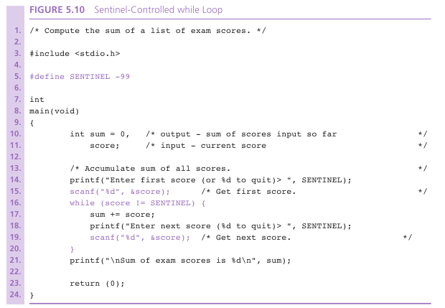

Slide 33
Endfile-Controlled Loop Design
Get the first data value and save input status
while input status does not indicate that end of file has been reached
Process data value
Get next data value and save input status

Slide 34
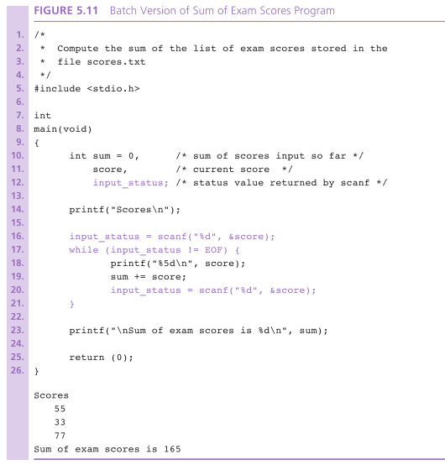

Slide 35
Nested Loops
Loops may be nested just like other control structures
Nested loops consist of an outer loop with one or more inner loops
Each time the outer loop is repeated, the inner loops are reentered, their loop control expressions are reevaluated, and all required iterations are performed

Slide 36
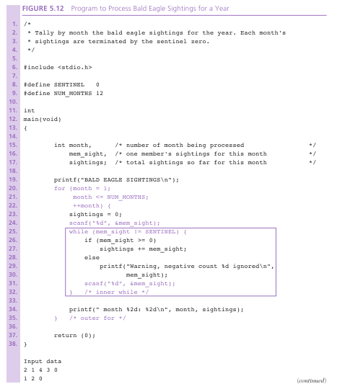

Slide 37
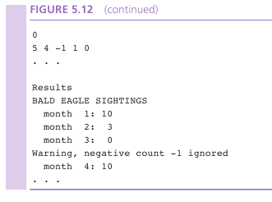

Slide 38
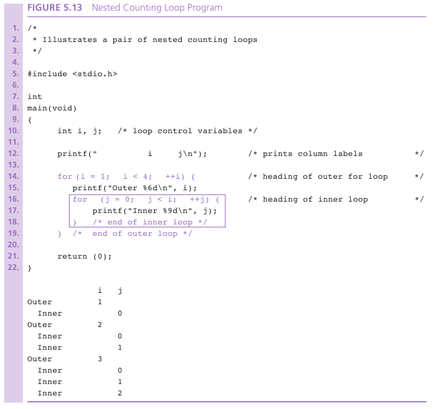

Slide 39
do-while Statement
For conditions where we know that a loop must execute at least one time
Get a data value
If data value isn’t in the acceptable range, go back to step 1.

Slide 40
do-while Syntax
do
statement;
while (loop repetition condition);
/* Find first even number input */
do
status = scanf(“%d”, &num);
while (status > 0 && (num % 2) != 0);

Slide 41
Flag-Controlled Loops for Input Validation
Sometimes a loop repetition condition becomes so complex that placing the full expression in its usual spot is awkward
Simplify the condition by using a flag
flag
a type int variable used to represent whether or not a certain event has occurred
1 (true) and 0 (false)

Slide 42
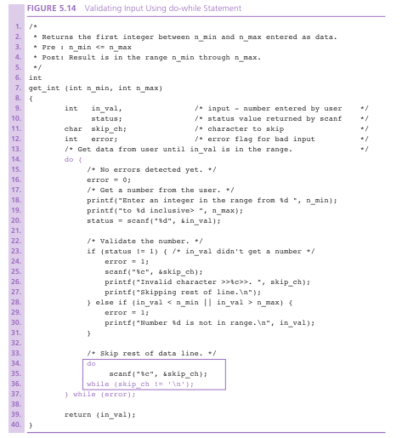

Slide 43
End Of File

Slide 44
/*A payroll program for the company XYZ*/
#include <stdio.h>
int
main()
{
double total_pay;
int count_emp;
int number_emp;
double hours;
double rate;
doble pay;
/*Get number of employee*/
printf("Enter number of Employee in the company:");
scanf("%d", &number_emp);

Slide 45
/*Compute each employee pay and add it to the payroll*/
total_pay = 0.0;
count_emp = 0;
while(count_emp < number_emp){
printf("Hours worked:");
scanf("%1f", &hours);
printf("Rate of payment:");
scanf("%1f", &rate);
pay = hours * rate;
printf("Pay is $%6.2f\n\n", pay);
total_pay = total_pay +pay
count_emp = count_emp +1;
}
printf("All employee processed\n");
printf("Total payroll is $%8.2f\n", total_pay);
return (0);}
BACK

